Slide 1

Data Communication & Networks
Spring-2021
(Week-3)
Course Teachers: Mr. Waleej Haider (Asst. Prof),
MS Razia Nisar noorani (Asst. Prof)
Department of Computer Science & Information Technology

Slide 2

4. Protocols
Key elements of a protocol
Syntax: Structure or format of data
Semantics: meaning of each section of bits in the structure
Timing: when data should be sent and how fast they can be sent
Notes:
Syntax. The term syntax refers to the structure or format of the data, meaning the order in which they are presented. For example, a simple protocol might expect the first 8 bits of data to be the address of the sender, the second 8 bits to be the address of the receiver, and the rest of the stream to be the message itself. Semantics. The word semantics refers to the meaning of each section of bits. How is a particular pattern to be interpreted, and what action is to be taken based on that interpretation? For example, does an address identify the route to be taken or the final destination of the message?
Timing. The term timing refers to two characteristics: when data should be sent and how fast they can be sent. For example, if a sender produces data at 100 Mbps but the receiver can process data at only 1 Mbps, the transmission will overload the receiver and some data will be lost.

Slide 3


What’s a protocol?
a human protocol and a computer network protocol:
Hi
TCP connection
request
Hi
TCP connection
response
Got the
time?
Get http://www.awl.com/kurose-ross
2:00
<file>
time

Slide 4
Chapter 1: roadmap
1.1 What is the Internet?
1.2 Network edge
end systems, access networks, links
1.3 Network core
circuit switching, packet switching, network structure
1.4 Delay, loss and throughput in packet-switched networks
1.5 Protocol layers, service models
1.6 Networks under attack: security
1.7 History

Slide 5
1.2 Network edge
Computers and other devices connected to the Internet are often referred to as end systems (because they sit at the edge of the Internet).
desktop computers (e.g., desktop PCs, Macs, and Linux boxes),
servers (e.g., Web and e-mail servers), and
mobile computers (e.g., portable computers, PDAs, and phones with wireless Internet connections).

Slide 6
Continued…
End systems are also referred to as hosts because they host (that is, run) application programs :
Web browser program, a Web server program, an e-mail reader program, or an e-mail server program.
Two categories: clients (desktop and mobile PCs, PDAs, and so on ) and servers (machines that store and distribute Web pages, stream video, relay e-mail, and so on)

Slide 7
Client and Server Programs
A client program is a program running on one end system that requests and receives a service from a server program running on another end system.
The Web, e-mail, file transfer, remote login, newsgroups, and many other popular applications adopt the client- server model.

Slide 8
peer-to-peer (P2P) applications
Increasingly, many applications are peer-to-peer (P2P) applications, in which end systems interact and run programs that perform both client and server functions.
For example, in P2P file-sharing applications (such as BitTorrent and eMule), the program in the user's end system acts as a client when it requests a file from another peer; and the program acts as a server when it sends a file to another peer.

Slide 9

The Network Core
mesh of packet switches and links that interconnects the Internet's end systems.
The fundamental question: how is data transferred through net?
circuit switching
packet-switching

Slide 10
In circuit-switched networks, the resources needed along a path (buffers, link transmission rate) to provide communication between the end systems are reserved for the duration of the communication session between the end-systems. E.g. telephone net
In packet-switched networks, these resources are not reserved; a session's messages use the resources on demand, and as a consequence, may have to wait (that is, queue) for access to a communication link. E.g. Internet
Notes:
Packet Switching: In a network application, end systems exchange messages with each other. Messages can contain anything the application designer wants. Messages may perform a control function (for example, the “Hi” messages in our handshaking example in Figure 1.2) or can contain data, such as an email message, a JPEG image, or an MP3 audio file. To send a message from a source end system to a destination end system, the source breaks long messages into smaller chunks of data known as packets. Between source and destination, each packet travels through communication links and packet switches (for which there are two predominant types, routers and linklayer switches). Packets are transmitted over each communication link at a rate equal to the full transmission rate of the link. So, if a source end system or a packet switch is sending a packet of L bits over a link with transmission rate R bits/sec, then the time to transmit the packet is L/R seconds.
Store-and-Forward Transmission: Most packet switches use store-and-forward transmission at the inputs to the links. Store-and-forward transmission means that the packet switch must receive the entire packet before it can begin to transmit the first bit of the packet onto the outbound link.

Slide 11
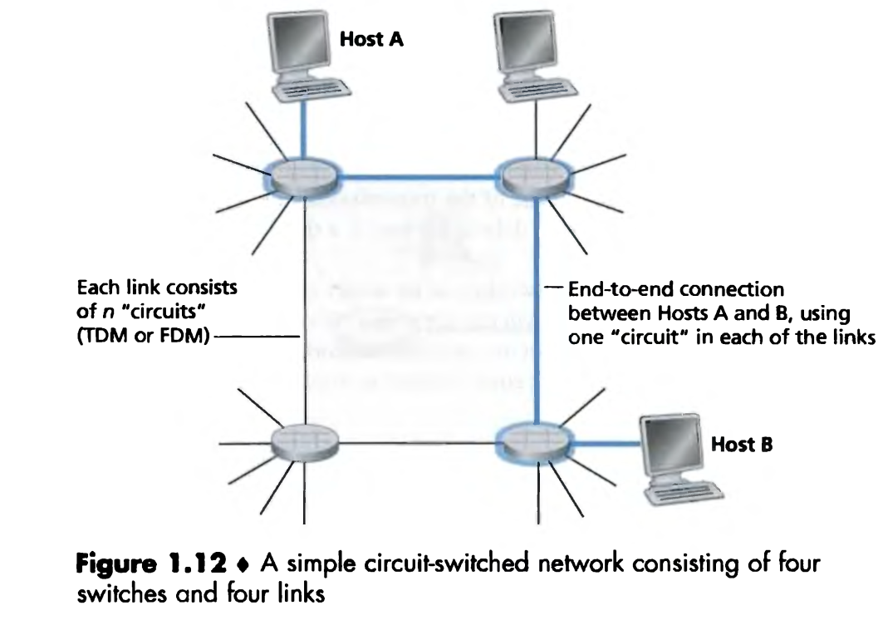
Circuit Switching
In this network, the four circuit switches are interconnected by four links.
Each of these links has n circuits, so that each link can support n simultaneous connections.
The hosts are each directly connected to one of the switches.
When two hosts want to communicate, the network establishes a dedicated end-to-end connection between the two hosts. E.g. Conference calls between A and B.

Slide 12
(Continued…)
for Host A to send messages to Host B, the network must first reserve one circuit on each of two links.
Because each link has n circuits, for each link used by the end-to-end connection, the connection gets a fraction 1/n of the link's bandwidth for the duration of the connection.

Slide 13
Multiplexing in Circuit-Switched Networks
A circuit in a link is implemented :
frequency-division multiplexing (FDM)
time-division multiplexing (TDM).
With FDM, the frequency spectrum of a link is divided up among the connections established across the link.
The link dedicates a frequency band to each connection for the duration of the connection.
In telephone networks, this frequency band typically has a width of 4 kHz

Slide 14
FM radio stations also use FDM to share the frequency spectrum between 88 MHz and 108 MHz, with each station being allocated a specific frequency band.
For a TDM link, time is divided into frames of fixed duration, and each frame is divided into a fixed number of time slots.
When the network establishes a connection across a link, the network dedicates one time slot in every frame to this connection.

Slide 15
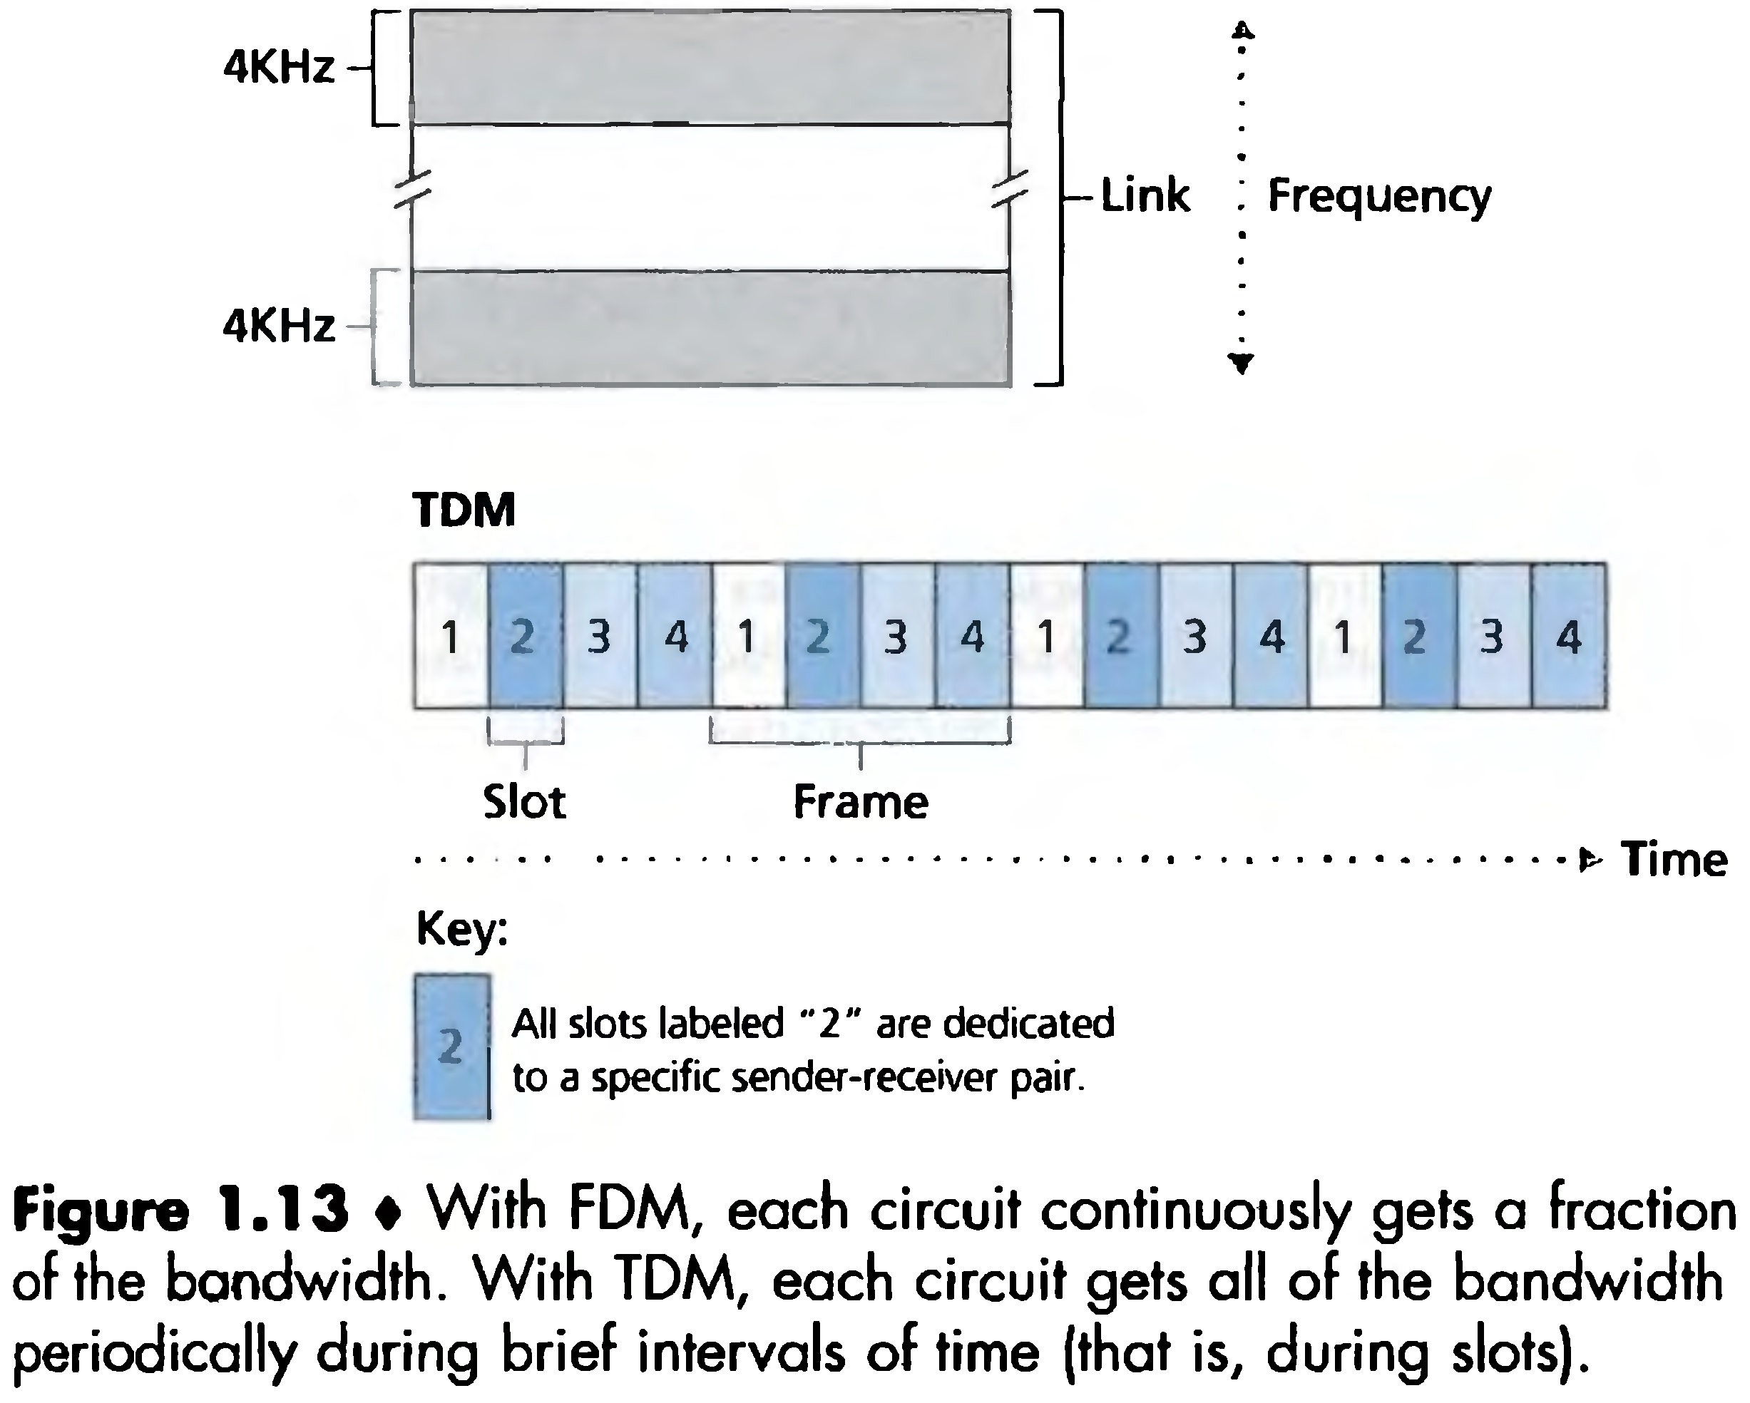

Slide 16
Circuit Switching: FDM and TDM
Example:
FDM
4 users
frequency
time
TDM
frequency
time
Notes:
Two simple multiple access control techniques.
Each mobile’s share of the bandwidth is divided into portions for the uplink and the downlink. Also, possibly, out of band signaling.
As we will see, used in AMPS, GSM, IS-54/136

Slide 17
Numerical example
How long does it take to send a file of 640,000 bits from host A to host B over a circuit-switched network?
All links are 1.536 Mbps
Each link uses TDM with 24 slots/sec
500 msec to establish end-to-end circuit
Let’s work it out!

Slide 18
Each circuit has a transmission rate of (1.536 Mbps)/24 = 64 kbps
so it takes (640,000 bits)/(64 kbps) = 10 seconds to transmit the file.
To this 10 seconds we add the circuit establishment time, giving 10.5 seconds to send the file.

Slide 19
Packet Switching
In computer networks, the source breaks long messages into smaller chunks of data known as packets.
Between source and destination, each of these packets travels through communication links and packet switches.
Packets are transmitted over each communication link at a rate equal to the full transmission rate of the link.

Slide 20
Continued…
Most packet switches use store-and-forward transmission at the inputs to the links.
Store-and-forward transmission means that the switch must receive the entire packet before it can begin to transmit the first bit of the packet onto the outbound link.
Thus store-and-forward packet switches introduce a store-and-forward delay at the input to each link along the packet's route.

Slide 21
Packet-switching: store-and-forward
L
R
R
R
Takes L/R seconds to transmit (push out) packet of L bits on to link or R bps
Entire packet must arrive at router before it can be transmitted on next link: store and forward
delay = 3L/R (assuming zero propagation delay)
Example:
L = 7.5 Mbits
R = 1.5 Mbps
delay = 15 sec
more on delay shortly …

Slide 22
Task-1:
Write a summary of the following topics:
Circuit Switching
Packet Switching
------------------------------------------------------------------------------------------------------------------------------------------------------------------------------------------------------------------------------------------------------------------------------------------------------------------------------------------------------------------------------------------------------------------------------------------------------------------------------

Slide 23
NOTE:
Prepare a list of questions to be answered in the class
Be Prepared for a short quiz from the above topics

